Slide 1
Monday, October 22, 2012
TISK Problems
Find the slope of a line that passes through the points (4, 3) and (-2, 7).
Write an equation of a line that is perpendicular to the line with the equation $y=−3x+1$.
Write the equation of a line in slope-intercept form that passes through the point (5, 3) and is parallel to the line with the equation $y=\frac{5}{2}x+1$.
We will have 3 Mental math Questions today.
Homework: p. 211 #28-34 even
Notes:
Mental Math
Start with the square of 16. Divide by 4. Take the cube root. (4)
Start with the square of 9. Divide by 3. Take the cube root. (3)
Start with the square of 25. Divide by 5. Take the cube root. (5)

Slide 2
§4-4 Proving Triangles Congruent
There are other ways to prove triangles congruent than proving all corresponding parts congruent.
3 Postulates
SSS Postulate (Side-Side-Side Postulate)
If the sides of one triangle are congruent to the sides of a second triangle, then the triangles are congruent.
SAS Postulate (Side-Angle-Side Postulate)
If two sides and the included angle of one triangle are congruent to two sides and the included angle of another triangle, then the triangles are congruent.
ASA Postulate (Angle-Side-Angle Postulate)
If two angles and the included side of one triangle are congruent to two angles and the included side of another triangle, then the triangles are congruent.

Slide 3
§4-4 Proving Triangles Congruent
Given:
$∠1$ and $∠2$ are right angles
$\overline{ST}≅\overline{TP}$
Prove:
$∆STR≅∆PTR$
S
5
1
3
T
R
2
4
6
P

Slide 4
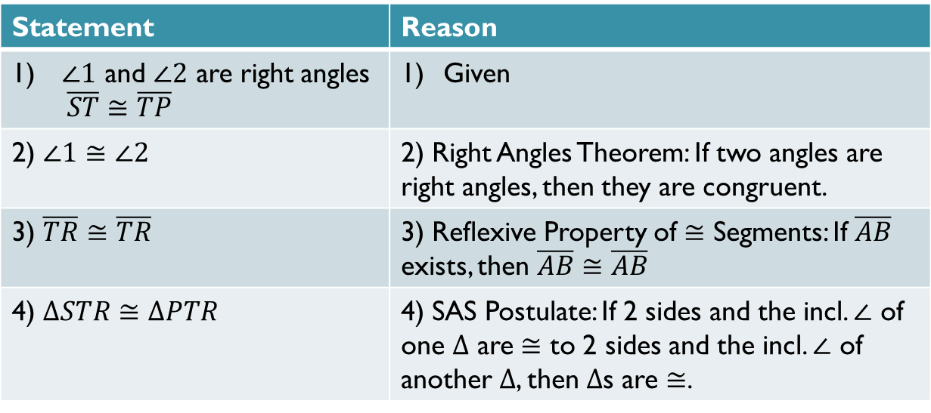
Completed Proof: (done together in class)
Statement | Reason
$∠1$ and $∠2$ are right angles $\overline{ST}≅\overline{TP}$ | Given
2) $∠1≅∠2$ | 2) Right Angles Theorem: If two angles are right angles, then they are congruent.
3) $\overline{TR}≅\overline{TR}$ | 3) Reflexive Property of $≅$ Segments: If $\overline{AB}$ exists, then $\overline{AB}≅\overline{AB}$
4) $∆STR≅∆PTR$ | 4) SAS Postulate: If 2 sides and the incl. $∠$ of one $∆$ are $≅$ to 2 sides and the incl. $∠$ of another $∆$, then $∆$s are $≅$.

Slide 5
Homework
p. 211 #28-34 even

